Slide 1
Can PPML Keep Your Data Private? Evaluating Privacy Techniques Against Inference Attacks
Noam Tarshish
Daniel Hodisan
Lavi Ben-Shimol
Link to Repository: https://github.com/hodisan94/ppml_project

Slide 2
Motivation
Machine learning models often require access to sensitive user data (e.g., medical records, financial history).
Traditional ML pipelines centralize data, increasing the risk of:
Data breaches
Unauthorized access
Non-compliance with regulations (e.g., GDPR, HIPAA)
Organizations must protect user privacy while still leveraging data for insights.

Slide 3
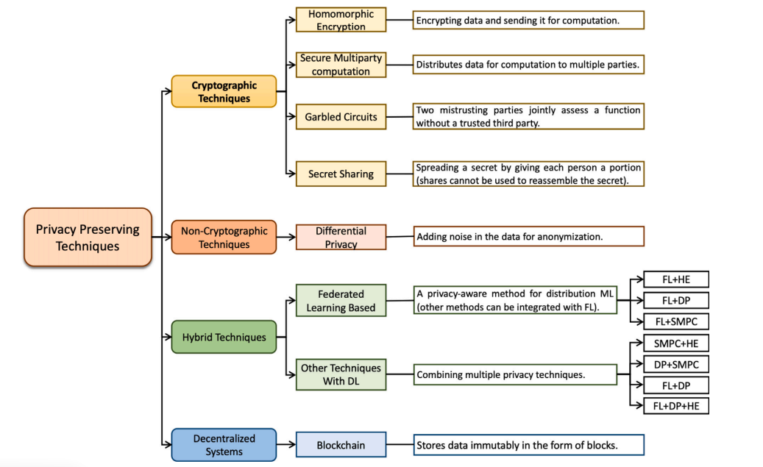
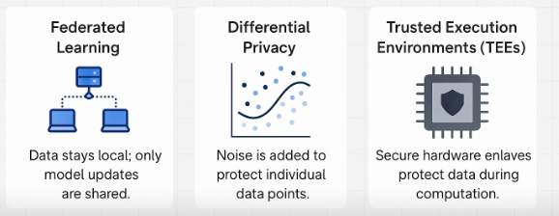
Privacy-Preserving Machine Learning (PPML)
PPML is a set of techniques that allow machine learning models to be trained and used without exposing raw data.
Notes:
`

Slide 4
Project Objectives
Goal: Explore how confidential computing can be used in privacy-preserving machine learning.
Provide a dataset of sensitive information (e.g., medical records or financial data)
Train a machine learning model on this dataset using federated learning or secure aggregation techniques.
Discuss how confidential computing ensures that the data remains private while the model is trained.
Evaluate the trade-offs between privacy, model accuracy, and computational efficiency

Slide 5

Methodology

Slide 6
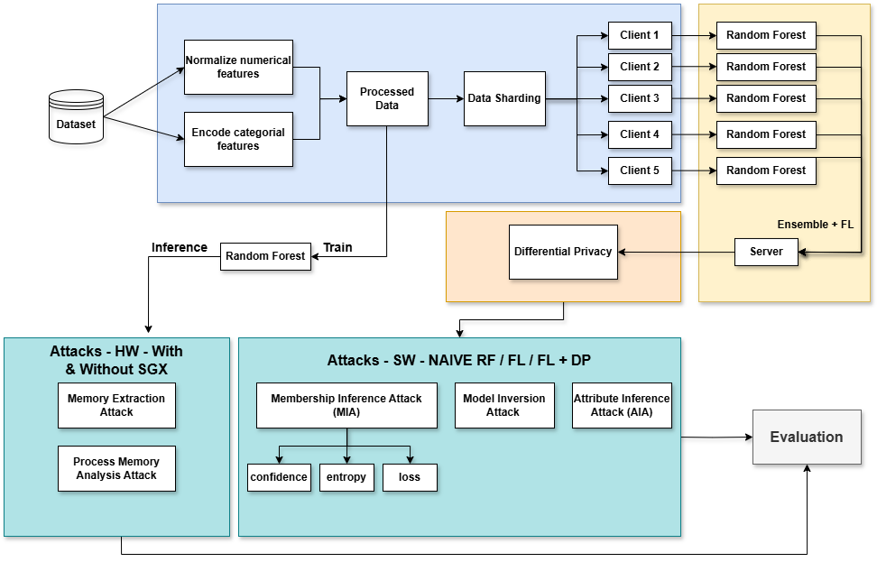
Project Objectives

Slide 7

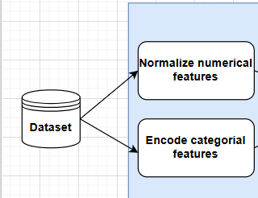
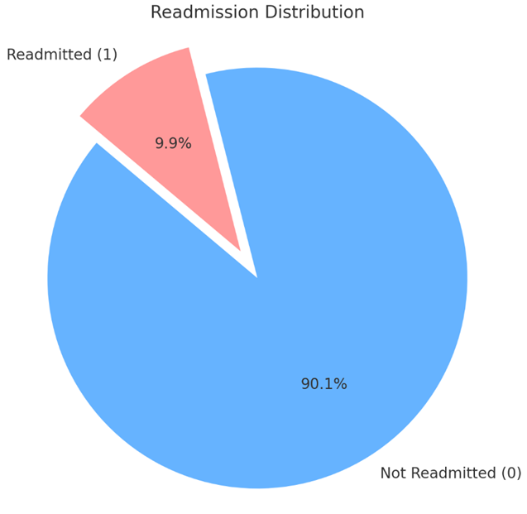
Dataset
Task:
Predict whether a patient will be readmitted within 30 days after discharge.
Dataset Overview:
55,500 synthetic patient records
19 features: age, gender, medical condition, insurance, etc.
Binary label: Readmitted (0 = No, 1 = Yes)
Class imbalance (~90% No, 10% Yes) handled with SMOTE
Why it's a good fit for PPML:
Mimics privacy sensitive hospital data
Clean structure for Federated Learning (5 clients = 5 hospitals)
Balanced and interpretable for privacy benchmarking

Slide 8
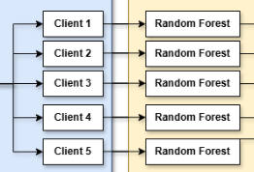
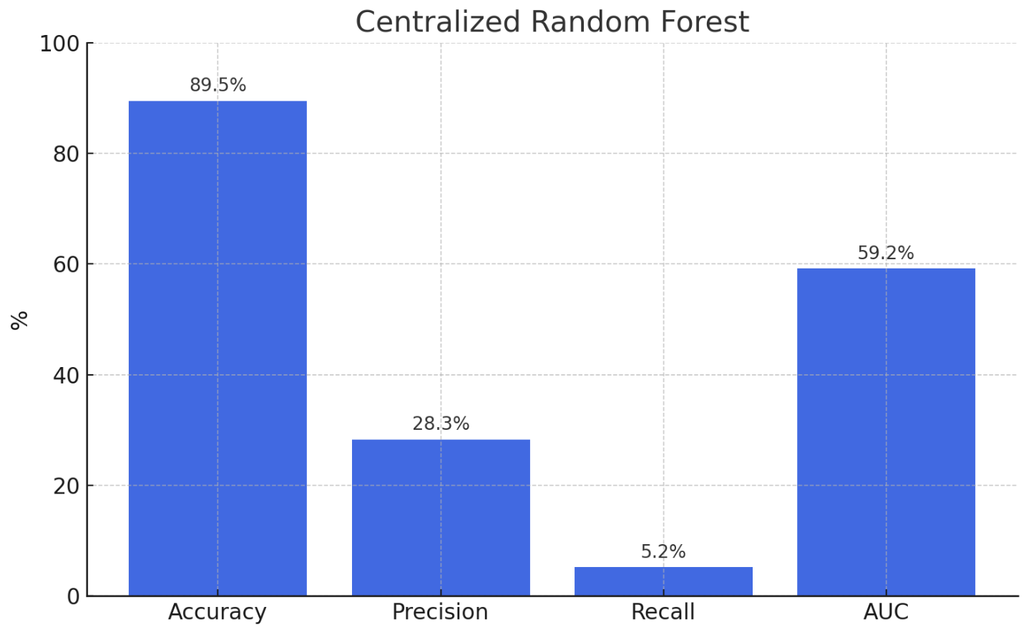
Random Forest
Models Used:
Centralized Random Forest (Baseline)
Federated Random Forest (FL with 5 clients)
Federated Random Forest + Differential Privacy (FL + DP)
Baseline Results (Centralized):
Accuracy: 89.5%
Precision: 28.3%
Recall: 5.2%
AUC: 0.592
Why Random Forest?
Strong performance on tabular data, even without heavy tuning
Handles complex feature interactions and non-linear relationship
Suitable for comparison across centralized, federated, and privacy-preserving setups

Slide 9
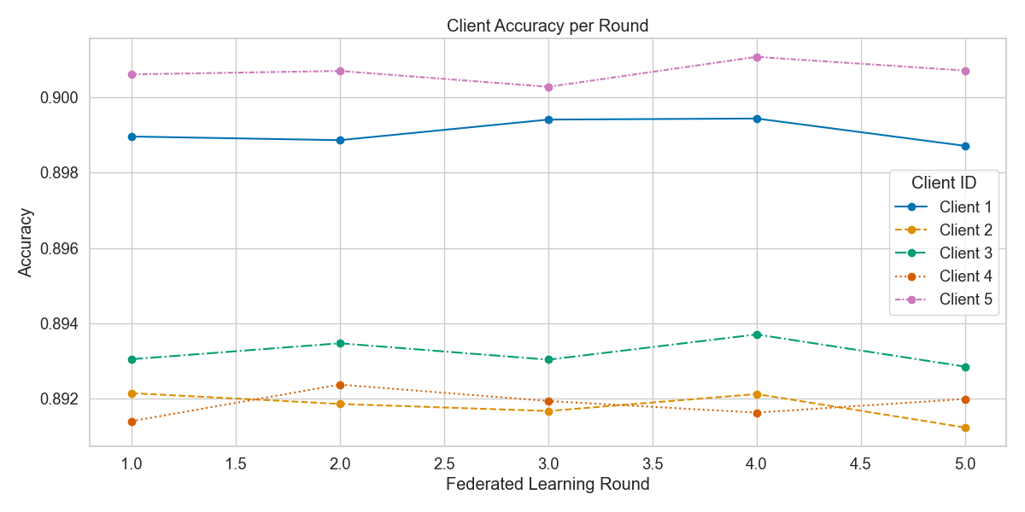
Federated Learning
Clients: 5 simulated clients, each with a unique shard of the healthcare dataset
Server: Aggregates local updates using Ensemble

Slide 10

Differential Privacy
Even with FL, model updates can leak sensitive info
DP prevents this by adding noise during training
Gaussian noise is added to each client’s prediction vector before aggregation
The privacy utility trade-off is controlled using ε, a tunable noise parameter
Accuracy is preserved, while inference attacks become significantly less effective.

Slide 11
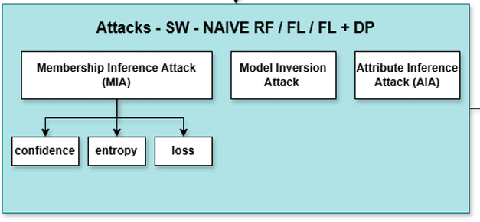
Attack Simulations
Membership Inference Attack (MIA) - Determine whether a specific data point was part of the model’s training set. Simulated using 3 scoring signals:
Confidence
Entropy
Cross-entropy loss
Model Inversion Attack - Reconstruct sensitive input features by leveraging the model’s output values. Evaluated using MSE between true and predicted inputs.
Attribute Inference Attack (AIA) - Infer hidden sensitive attributes (e.g., gender, blood type) from model predictions and known features.

Slide 12
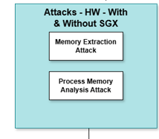
SGX Integration
To evaluate defenses against privileged adversaries with full system access, we implemented a hardware-based protection setup using Intel Software Guard Extensions (SGX).
Implementation Steps:
Model Wrapping: A trained Random Forest model is selected for secure inference.
Gramine Integration: The Python-based inference script is ported into a secure SGX en clave using the Gramine LibOS framework.
Manifest Configuration: Security policies, file access rules, and enclave memory allocation are defined using a Gramine manifest file.
Attestation and Launch: The enclave is launched and remote attestation confirms its integrity and genuine SGX environment.
Attack Simulation: We attempt to extract model coefficients and patient inputs using direct memory read and process memory analysis, both with and without SGX.

Slide 13
Evaluation

Slide 14
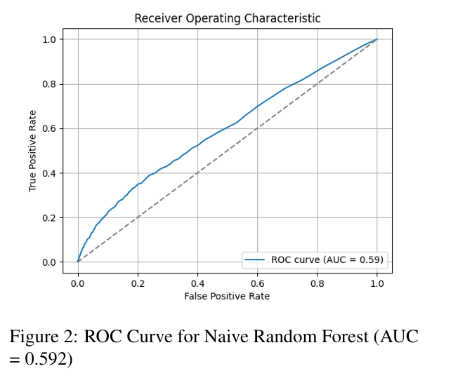
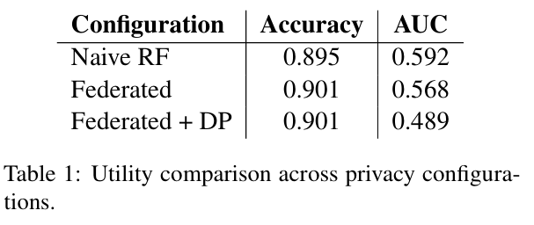
Model Utility Evaluation
We begin by evaluating the utility of each configuration using classification performance metrics.

Slide 15
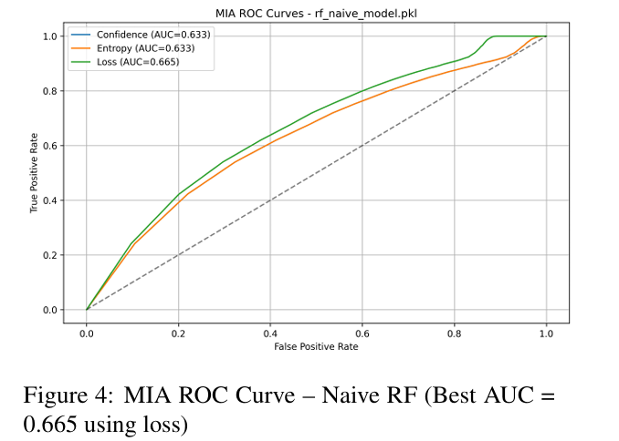
Membership Inference Attack (MIA)
We evaluate the vulnerability of each training configuration to membership inference attacks.
Insights:
The Naïve RF model is the most vulnerable to MIA, with an AUC of 0.665 using the loss signal, show casing significant attack success compared to random chance (0.5)

Slide 16
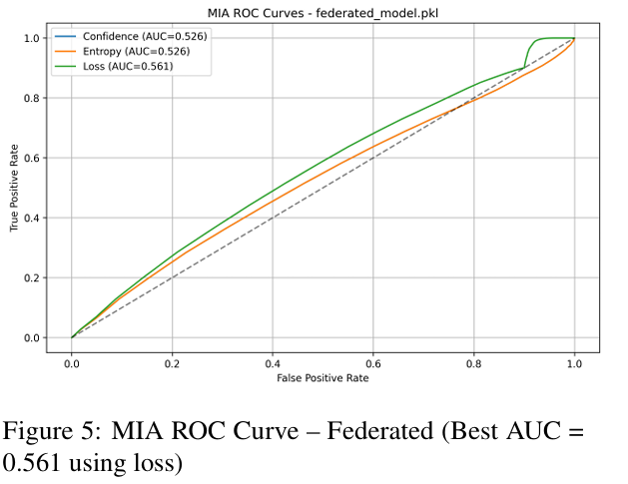
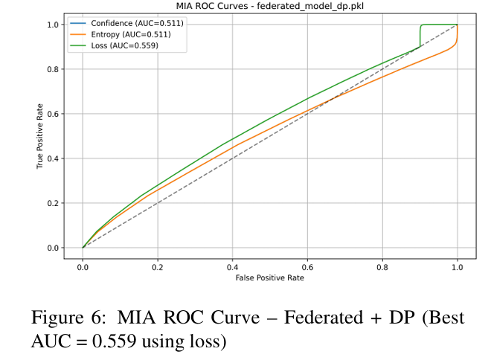
Membership Inference Attack (MIA)
Insights (cont.):
Federated training lowers the attack success rate slightly (AUC = 0.561), likely due to ensemble variance between clients.
The addition of Differential Privacy further de creases the adversary’s ability to infer membership. However, the AUC still remains above 0.5, indicating partial leakage.

Slide 17
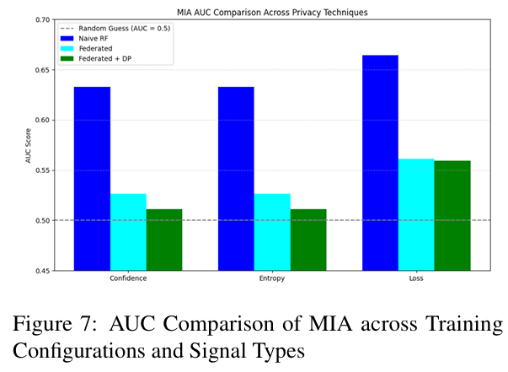
Membership Inference Attack (MIA)
Summary:
the loss metric consistently provides the highest leakage signal across all set tings, while confidence and entropy provide weaker but still non-trivial signals

Slide 18
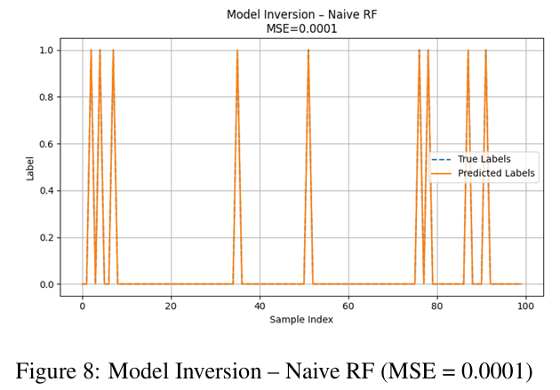
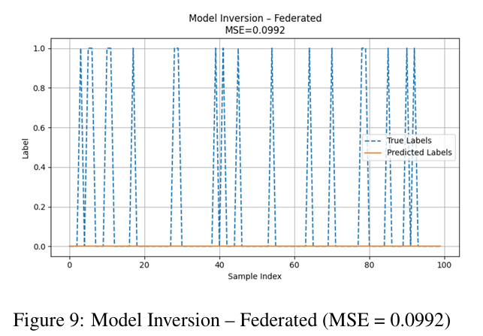
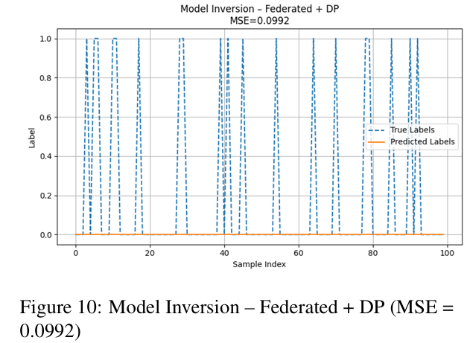
Model Inversion Attack
Insights:
The Naive RF model is highly vulnerable to inversion attacks, with an extremely low MSE (0.0001), meaning the predicted values almost perfectly match the true labels
Federated Learning significantly reduces the attack’s effectiveness (MSE increases to 0.0992). Interestingly, adding Differential Privacy to the federated setup does not further increase the MSE

Slide 19
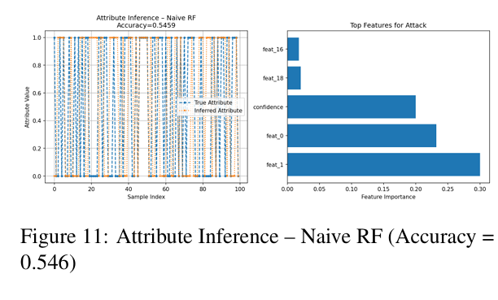
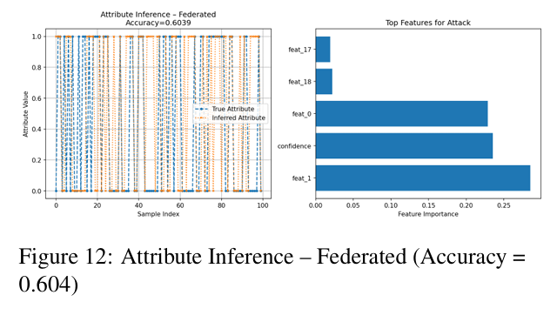
Attribute Inference Attack (AIA)
Insights:
Surprisingly, the federated setup shows higher at tribute inference accuracy (0.604) than the Naive RF (0.546).

Slide 20
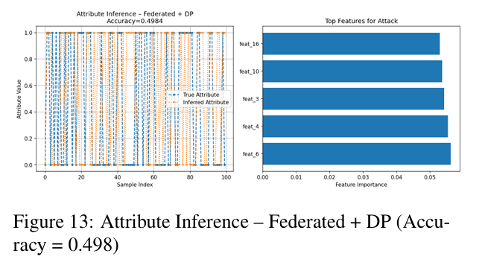
Attribute Inference Attack (AIA)
Insights:
When Differential Privacy is applied in the federated setup, the attack’s accuracy drops to 0.498 — nearly indistinguishable from random guessing.

Slide 21
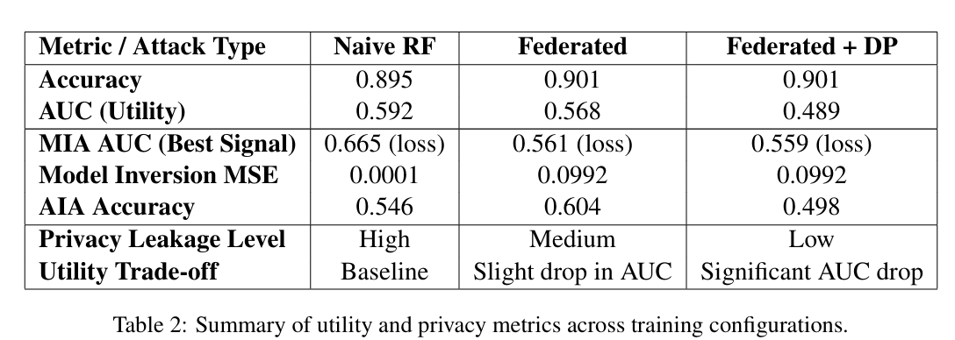
Attacks Summary

Slide 22
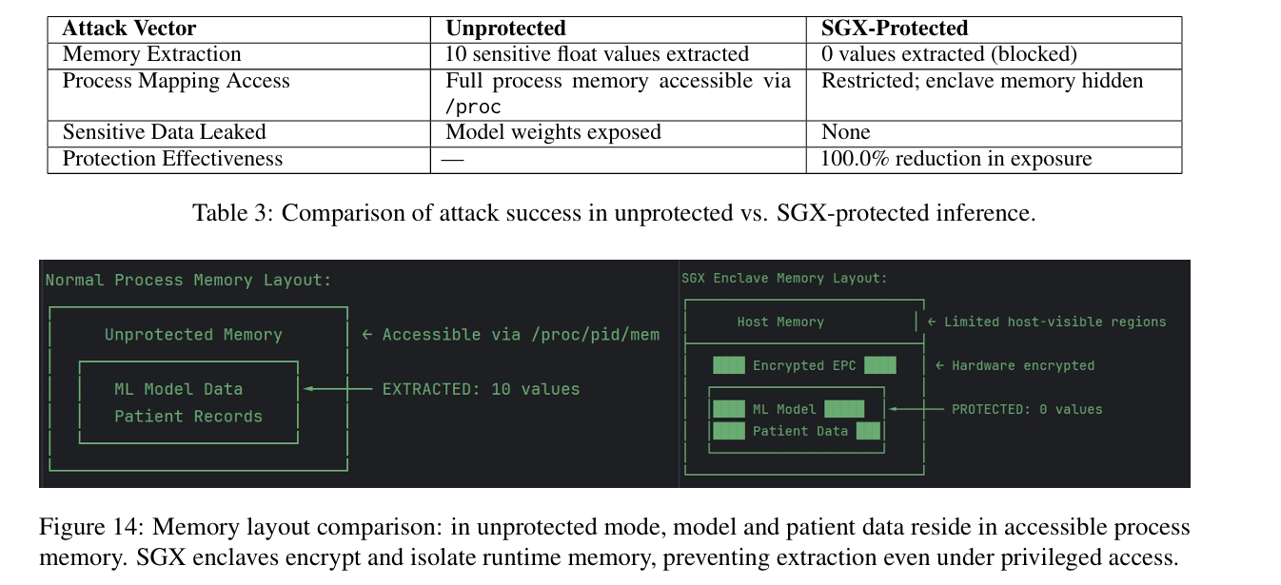
SGX-Based Memory Attack Evaluation
The attacks were executed in both non-enclave and SGX-enclave modes.
Insights:
SGX enclaves provide hardware-level memory encryption and process isolation, eliminating the attack surface available in traditional memory layouts.
The results confirm that SGX provides robust run time confidentiality, complementing inference-time defenses like FL and DP.

Slide 23

Conclusions

Slide 24
Conclusions
Utility: Federated Learning slightly improved accuracy over the centralized baseline while maintaining similar AUC.
MIA Resistance: Naive RF was highly vulnerable to MIA (AUC = 0.665), while FL reduced this to 0.561. The addition of DP slightly lowered attack performance to 0.559, suggesting moderate added value.
Inversion Robustness: The centralized model was highly exposed (MSE = 0.0001), while both FL and FL + DP increased MSE to 0.0992

Slide 25
Conclusions
AIA Leakage: FL led to the highest attribute inference accuracy (0.604), likely due to local overfitting. Applying DP reduced inference accuracy to near-random levels (0.498), successfully mitigating the threat.
SGX Protection Effectiveness: In our hardware-based experiment, SGX success fully blocked memory extraction and process analysis attacks, reducing data exposure from 10 extracted model coefficients to 0.
Defense Layers: While FL and DP offer statistical and software-level privacy, SGX complements these defenses by addressing runtime memory threats.

Slide 26
Questions?
🙏

